Slide 1


Finite Automata Formal Languages
18CS52
(2022 – 2023)
Name | Shreyasa Joshi
USN | 1RV20CS198
Faculty | Dr. Chethana R Murthy
QUESTION
For the FAs pictured below, use the minimization algorithm (Equivalence) to find a minimum-state FA recognizing the same language. (It’s possible that the given FA may already be minimal.)

Slide 2
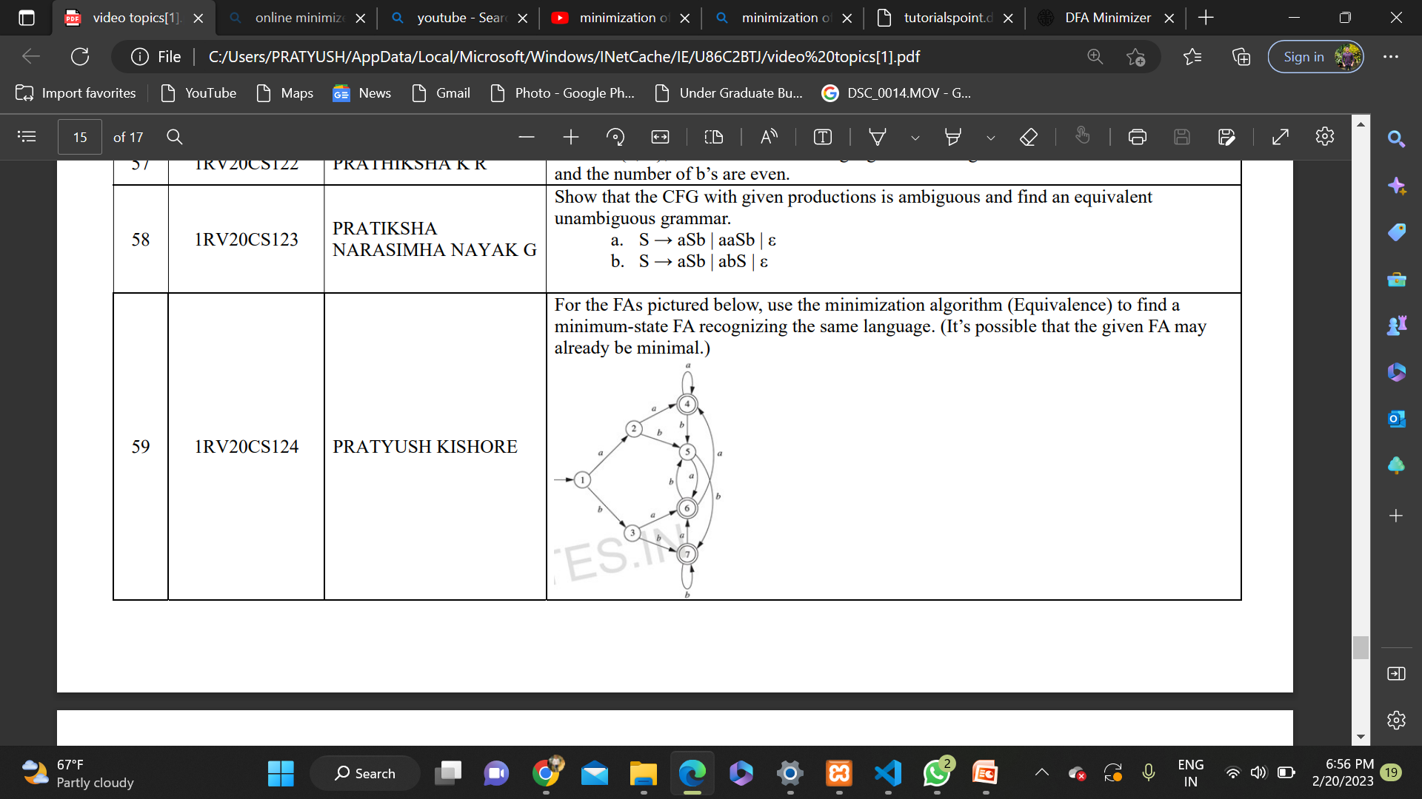
Question

Slide 3
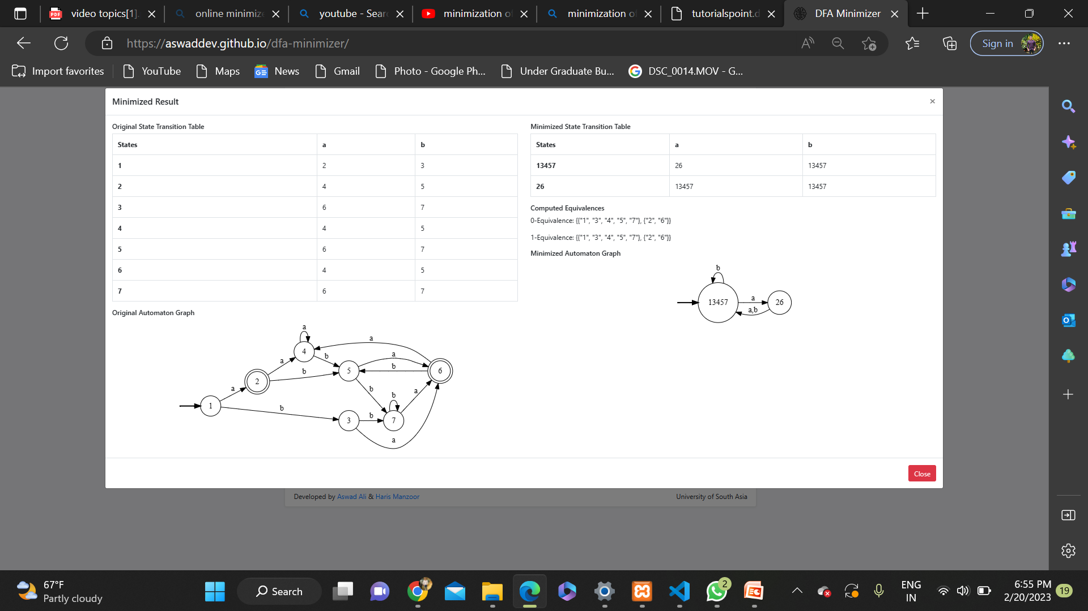
Solution

Slide 4
SOLUTION

